Slide 1
Revisiting Data Types
- Kavita Tewani

Slide 2
Numbers Revisited
Number Type Conversion
Type int(x) to convert x to a plain integer.
Type float(x) to convert x to a floating-point number.
Type complex(x) to convert x to a complex number with real part x and imaginary part zero.
Type complex(x, y) to convert x and y to a complex number with real part x and imaginary part y. x and y are numeric expressions.

Slide 3
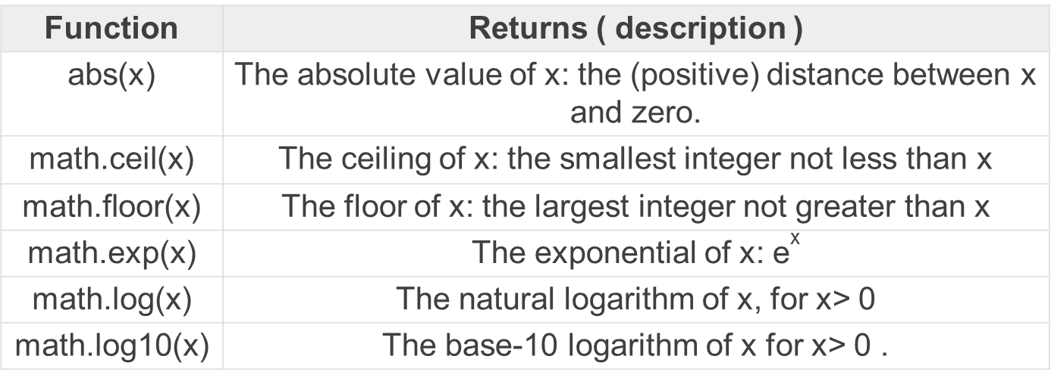
Numbers
Mathematical Functions

Slide 4
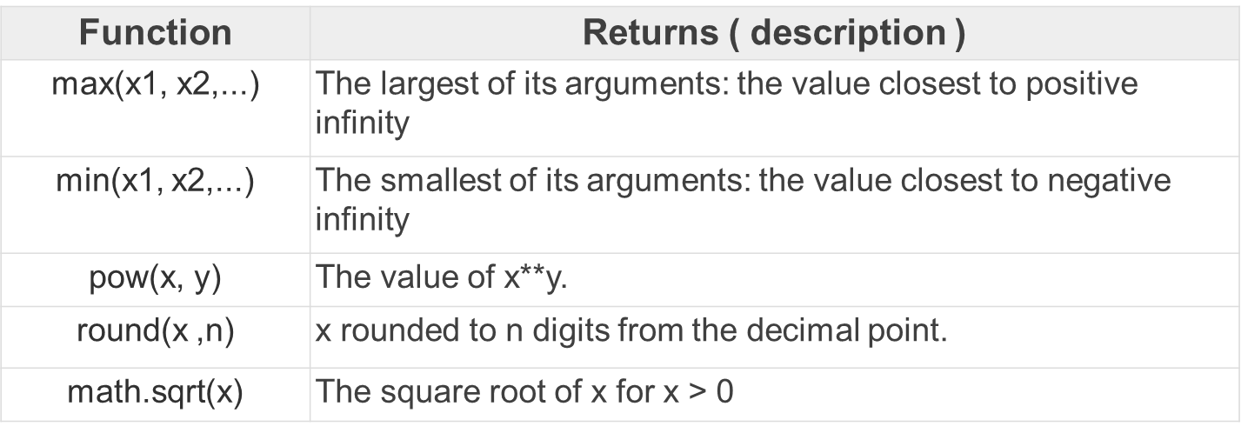

Slide 5
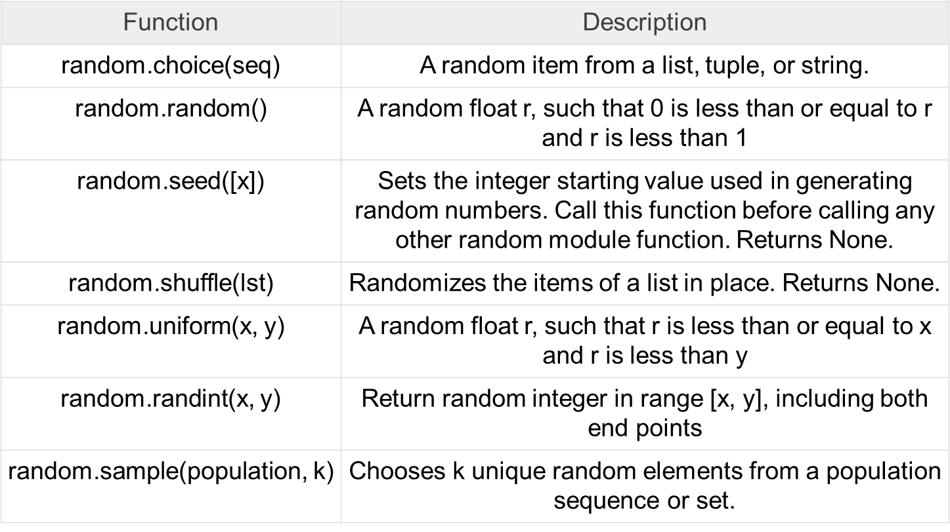
Random Number Functions

Slide 6
seed(): Seed function is used to save the state of a random function so that it can generate some random numbers on multiple executions of the code on the same machine or on different machines (for a specific seed value).

Slide 7
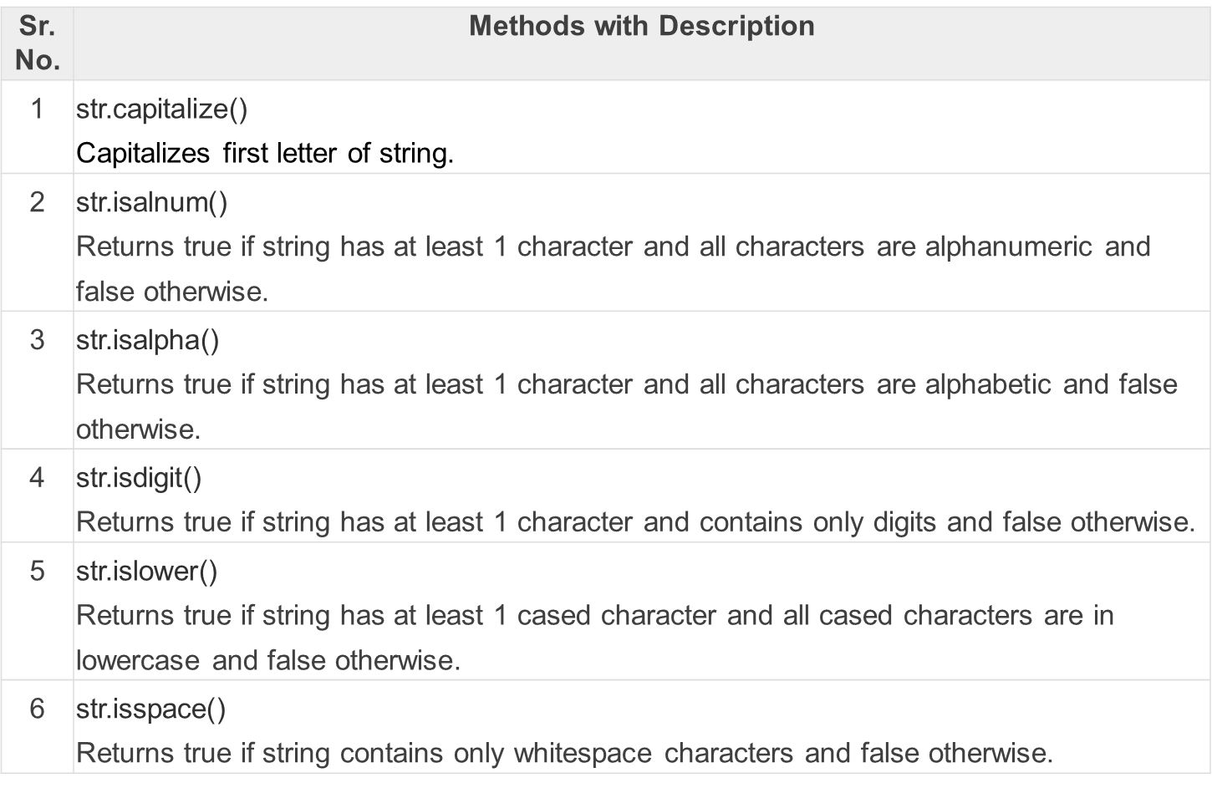
Strings revisited
Strings (Assume str to be a string variable)

Slide 8
